Slide 1
Lecture-3:
Classless Addressing
‹#›
Notes:
‹#›

Slide 2
Classful IP addressing Concept
IP address of Class C: 192.168.10.0
Two Parts:
Length of Net ID: 24 bits
Length Host ID: 8 bits
So, number of IP address of this block: 2⁸ = 256
Address Range:
first address: 192.168.10.0
last address: 192.168.10.255
Mask: 11111111 11111111 11111111 00000000
=> 255.255.255.0
‹#›

Slide 3
Classful IP addressing Concept
IP address: 192.168.10.0/27
Two Parts:
Length of Net ID: 27 bits
Length Host ID: 32-27 = 5 bits
So, number of IP address of this block: 2⁵ = 32
Address Range:
first address: 192.168.10.0
last address: 192.168.10.31
Mask: 11111111 11111111 11111111 11100000
=> 255.255.255.224
‹#›

Slide 4
Classful IP Address
Classless IP Address
IP address of Class C:
192.168.10.0
Two Parts:
Length of Net ID: 24 bits
Length Host ID: 8 bits
So, number of IP address of this block: 2⁸ = 256
Address Range:
First address: 192.168.10.0
Last address: 192.168.10.255
Mask: 11111111 11111111 11111111 00000000
=> 255.255.255.0
IP address:
192.168.10.0/27
Two Parts:
Length of Net ID: 27 bits
Length Host ID: 32-27 = 5 bits
So, number of IP address of this block: 2⁵ = 32
Address Range:
First address: 192.168.10.0/27
Last address: 192.168.10.31/27
Mask: 11111111 11111111 11111111 11100000
=> 255.255.255.224
‹#›

Slide 5
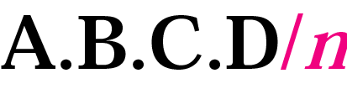
Slash Notation
To enable the variable-length blocks, the slash notation is introduced
Slash notation is also called CIDR notation
/prefix length represented using ‘1’, as masking.
The remaining unmasked ‘0’ is referred to the suffix length
CIDR = Classless InterDomain Routing
The n after the slash defines the number of bits that are the same in every address in the block. So if n is 20, it means the twenty leftmost bits are identical in each address.
‹#›
Notes:
‹#›

Slide 6
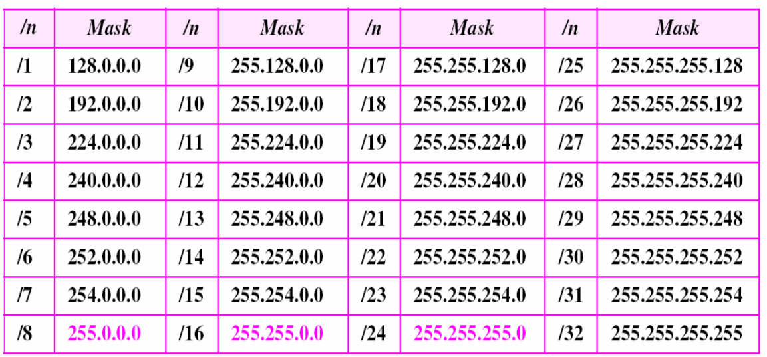
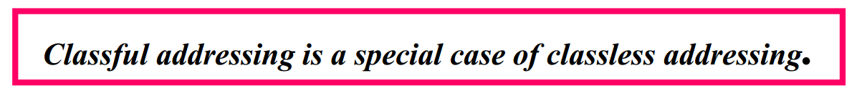
Prefix Length
‹#›

Slide 7
Classless Addressing Rules
Number of Addresses in a Block
There is only one condition on the number of addresses in a block; it must be a power of 2 (2, 4, 8, . . .).
For example, a household may be given a block of 2 addresses. A small business may be given 16 addresses. A large organization may be given 1024 addresses.
‹#›
Notes:
‹#›

Slide 8
Subnetting (Fixed Length)
Given, Network address: 192.168.10.0/27
Two Parts: Net ID: 27 bits & Host ID: 32-27 = 5 bits
So, number of IP address of this block: 2⁵ = 32
Address Range:192.168.10.0/27 ~ 192.168.10.31/27
Mask: 11111111 11111111 11111111 11100000
=> 255.255.255.224
Q. Now create 4 subnets of fixed length of IP addresses.
‹#›

Slide 9
Subnetting (Fixed Length)
Given, Network address: 192.168.10.0/27
Two Parts: Net ID: 27 bits & Host ID: 32-27 = 5 bits
So, number of IP address of this block: 2⁵ = 32
Address Range:192.168.10.0/27 ~ 192.168.10.31/27
Mask: 11111111 11111111 11111111 11100000 => 255.255.255.224
Q. Now create 4 subnets of fixed length of IP addresses.
Ans: Each Subnet size: 32/4 = 8 (2³) (# of IPs in each Subnet). So, Net ID of each subnet is 32-3 = 29 bits.
Therefore, IP address of each subnet is like: X.Y.Z.A/29
Subnet Mask:
11111111 11111111 11111111 11111000 => 255.255.255.248
‹#›

Slide 10
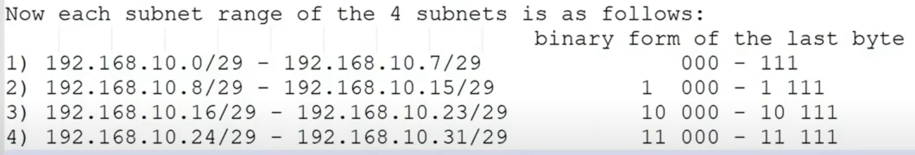
Subnetting (Fixed Length)
Given, Network address: 192.168.10.0/27
Two Parts: Net ID: 27 bits & Host ID: 32-27 = 5 bits
So, # of IP address of this block: 2⁵ = 32; Range:192.168.10.0/27 ~ 192.168.10.31/27
Q. Now create 4 subnets of fixed length of IP addresses.
Ans: Each Subnet size: 32/4 = 8 (2³) (# of IPs in each Subnet). So, Net ID of each subnet is 32-3 = 29 bits.
Therefore, IP address of each subnet is like: X.Y.Z.A/29
Subnet Mask: 11111111 11111111 11111111 11111000 => 255.255.255.248
‹#›

Slide 11
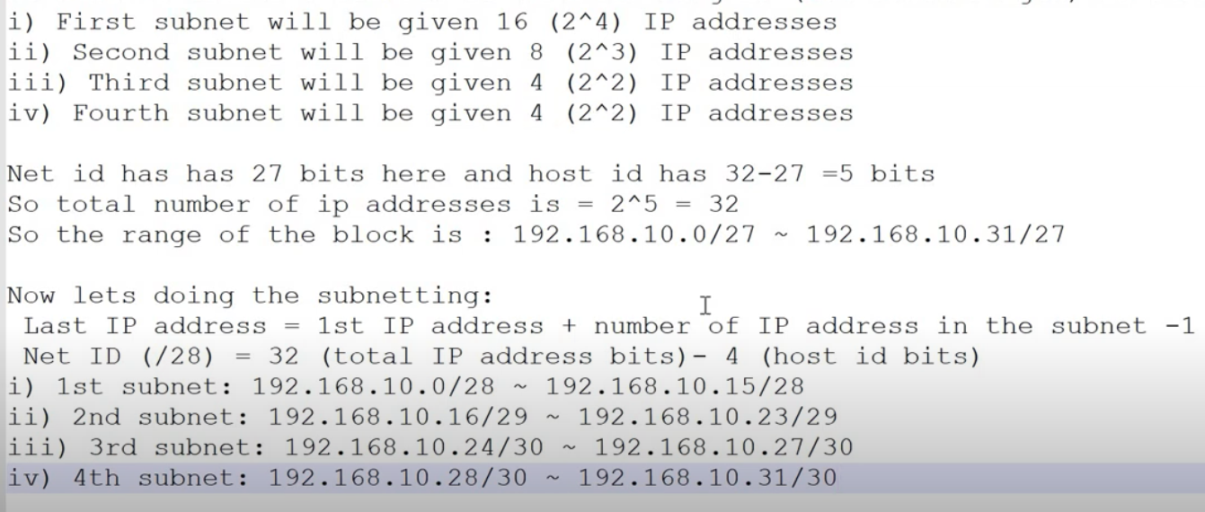
Subnetting (Variable Length)
Given, Network address: 192.168.10.0/27
Q. Now create 4 subnets of variable length of IP addresses as follows.
‹#›

Slide 12
More Examples about Subnetting
Fixed Length Subnetting:
https://youtu.be/y3MZtoe38_c
Variable Length Subnetting:
https://youtu.be/4fJVBaZM21E
‹#›

Slide 13
Classless Addressing Rules:
Number of Addresses in a Block
The number of addresses in a block must be a power of 2 (2, 4, 8, . . .)
Beginning Addresses
The beginning address must be evenly divisible by the number of addresses.
Ex: if a block contains 4 addresses, the beginning address must be divisible by 4.
Make the rightmost number of bits in the beginning address are zero
If the block has less than 256 addresses, we need to check only the rightmost byte.
If it has less than 65,536 addresses, we need to check only the two rightmost bytes, and so on.
‹#›

Slide 14
Example-1
Which of the following can be the beginning address of a block that contains 16 addresses?
205.16.37.32 190.16.42.44 17.17.33.80 123.45.24.52
Solution
The address 205.16.37.32 is eligible because .32 is divisible by 16. The address 17.17.33.80 is eligible because 80 is divisible by 16.
‹#›
Notes:
‹#›

Slide 15
Example-2
Which of the following can be the beginning address of a block that contains 256 addresses?
a.205.16.37.32 b.190.16.42.0 c.17.17.32.0 d.123.45.24.52
Solution
In this case, the right-most byte must be 0. When the right-most byte is 0, the total address is divisible by 256. Only two addresses are eligible (b and c).
‹#›

Slide 16
Example-3
Which of the following can be the beginning address of a block that contains 1024 addresses?
205.16.37.32 190.16.42.0 17.17.32.0 123.45.24.52
Solution
In this case, we need to check two bytes because 1024 = 4 × 256. The right-most byte must be divisible by 256 (should be 0). The second byte (from the right) must be divisible by 4. Only one address is eligible (c).
‹#›
Notes:
‹#›

Slide 17
Subnetting
Allows larger network break into a bunch of smaller networks.
For example—from one network creating six networks called subnetting.
Reasons of subnetting:
Reduced network traffic
Optimizing network performance
Simplified management
Facilitated spanning large geographical distances
‹#›

Slide 18
Finding The Blocks
When a classless address is given, we can find the block
The first address in the block
The number of addressed in the block
The last address in the block
‹#›

Slide 19
Finding The First Address
We can derive the first address if we know
One of the address in the block
The prefix length(n), or a mask, or the suffix length
Solution 1
AND the mask and the address to find the first address, i.e., network address
Solution 2
Just keep the first n bits and change the rest to 0s
‹#›

Slide 20
Example-4
What is the first address in the block if one of the addresses is 167.199.170.82/27?
The prefix length is 27
We must keep the first 27 bits as it is and change the remaining bits (5) to 0s.
The 5 bits affect only the last byte.
The last byte is 01010010.
Changing the last 5 bits to 0s, we get 01000000 or 64.
The network address is 167.199.170.64/27.
Address in binary: 10100111 11000111 10101010 01010010 Keep the left 27 bits: 10100111 11000111 10101010 01000000 Result in CIDR notation: 167.199.170.64/27
Solution
‹#›

Slide 21
Example-5
Find the first address in the block if one of the addresses is 140.120.84.24/20.
The first, second, and fourth bytes are easy;
For the third byte we keep the bits corresponding to the number of 1s in that group.
The first address is 140.120.80.0/20
Solution
See Next Slide
‹#›

Slide 22
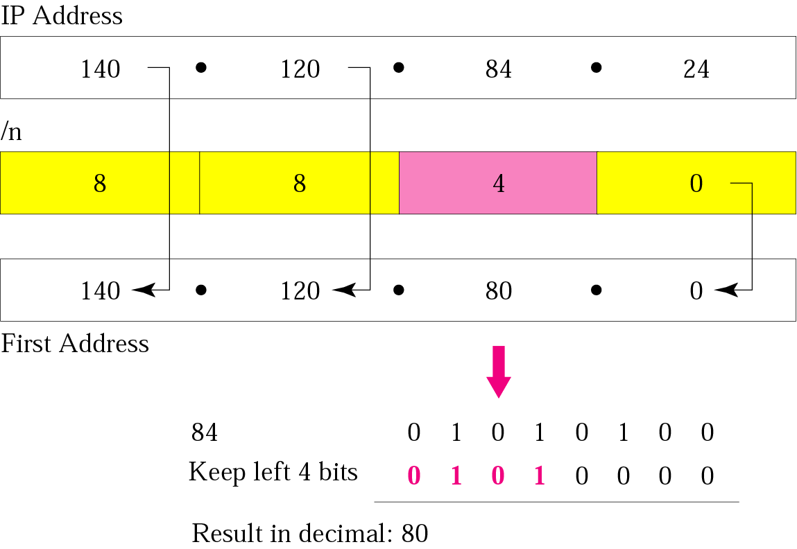
Example 5
‹#›

Slide 23
Example-6
Find the number of addresses in the block if one of the addresses is 140.120.84.24/20.
Solution
The prefix length is 20. The number of addresses in the block is 2³²⁻²⁰ or 2¹² or 4096. Note that this is a large block with 4096 addresses.
‹#›

Slide 24
Find the last address in the block
Two methods
First method
Add the number of addresses in the block minus 1 to the first address
Second method
Add the first address to the complement of the mask
‹#›

Slide 25
Example-7
Find the last address in the block if one of the addresses is 140.120.84.24/20.
Using the first method found in the example 7
The first address is 140.120.80.0/20
The number of addresses is 4096.
To find the last address
Add 4095 (4096 - 1) to the first address
Solution
‹#›

Slide 26
Example-7
Find the last address in the block if one of the addresses is 140.120.84.24/20.
Solution
Using second method: The mask has twenty 1s and twelve 0s. The complement of the mask has twenty 0s and twelve 1s. In other words, the mask complement is
00000000 00000000 00001111 11111111
or 0.0.15.255. We add the mask complement to the beginning address to find the last address.
See Next Slide
‹#›

Slide 27
Example-7
We add the mask complement to the beginning address to find the last address.
140 . 120 . 80 . 0 0 . 0 . 15 . 255 ---------------------------- 140 . 120 . 95 . 255
The last address is 140.120.95.255/20.
‹#›

Slide 28
Example-8
Find the block if one of the addresses is 190.87.140.202/29.
Follow the procedure in the previous examples to find:
The first address
The first address is 190.87.140.200/29
The number of addresses
The number of addresses is 2^(32-29) or 8
The last address
The last address is 190.87.140.207/20
Solution
‹#›

Slide 29
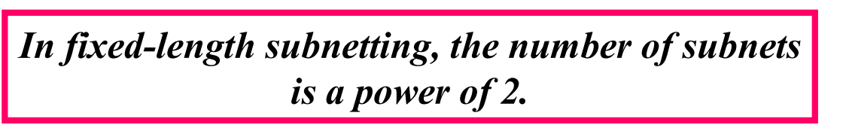
Finding the Number Subnet
Subnet prefix
Defined by the number of desired subnets
If the number of subnets is s
The number of extra 1s in the prefix length is log₂s
If we want fixed-length subnets
Each subnet has the same number of addresses
The number of subnets needs to be a power of 2
‹#›

Slide 30
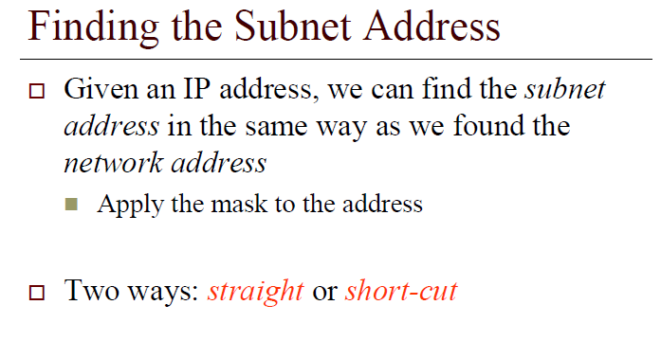
‹#›

Slide 31
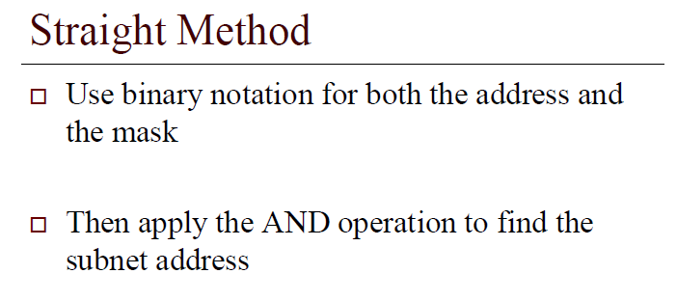
‹#›
Notes:
‹#›

Slide 32
Example-11
What is the subnetwork address if the destination address is 200.45.34.56 given that the subnet mask is 255.255.240.0?
11001000 00101101 00100010 00111000
11111111 11111111 11110000 00000000
11001000 00101101 00100000 00000000
The subnetwork address is 200.45.32.0
Solution
‹#›
Notes:
‹#›

Slide 33
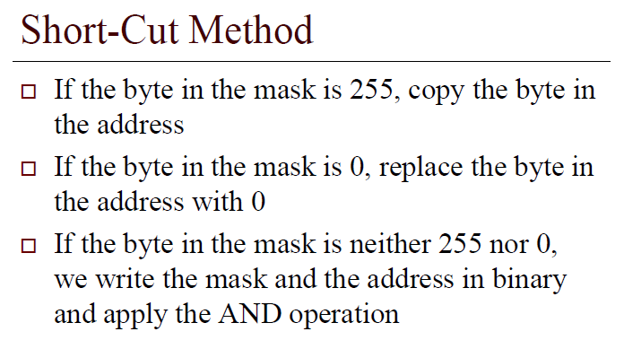
‹#›

Slide 34
Example-12
What is the subnetwork address if the destination address is 19.30.80.5 and the mask is 255.255.192.0?
‹#›
Notes:
‹#›

Slide 35
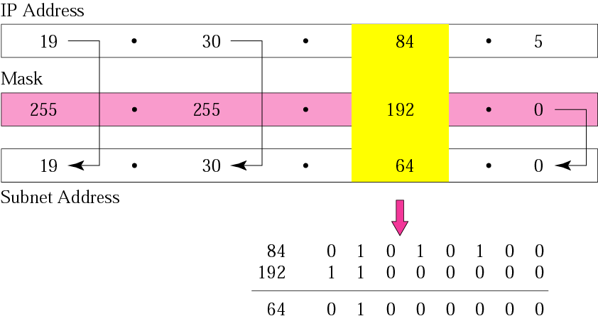
Solution
Answer: Subnet Address = 19.30.64.0
‹#›

Slide 36
Example-13
An organization is granted the network address block of 130.34.12.64/26. The organization needs to have four subnets. What are the subnet addresses and their range for each subnet?
We need 4 subnets
We need to add two more 1s (log₂ 4 = 2) to the site prefix.
The subnet prefix is then /28
Solution
‹#›

Slide 37
Solution
The suffix length is 6 (32-26). This means the total number of addresses in the block is 64 (2⁶).
If we create four subnets, each subnet will have 16 addresses.
Subnet 1: 130.34.12.64/28 to 130.34.12.79/28.
Subnet 2 : 130.34.12.80/28 to 130.34.12.95/28.
Subnet 3: 130.34.12.96/28 to 130.34.12.111/28.
Subnet 4: 130.34.12.112/28 to 130.34.12.127/28.
‹#›
Notes:
‹#›

Slide 38
Example-13
The first address in the first subnet is 130.34.12.64/28
Note that the first address of the first subnet is the first address of the block.
The last address of the subnet can be found by adding 15 (16 -1) to the first address.
The last address is 130.34.12.79/28
The first address in the second subnet is 130.34.12.80/28
Found by adding 1 to the last address of the previous subnet.
Again adding 15 to the first address, we obtain the last address, 130.34.12.95/28.
‹#›

Slide 39
Example-13
Similarly, we find the first address of the third subnet to be 130.34.12.96/28 and the last to be 130.34.12.111/28
Similarly, we find the first address of the fourth subnet to be 130.34.12.112/28 and the last to be 130.34.12.127/28
‹#›

Slide 40
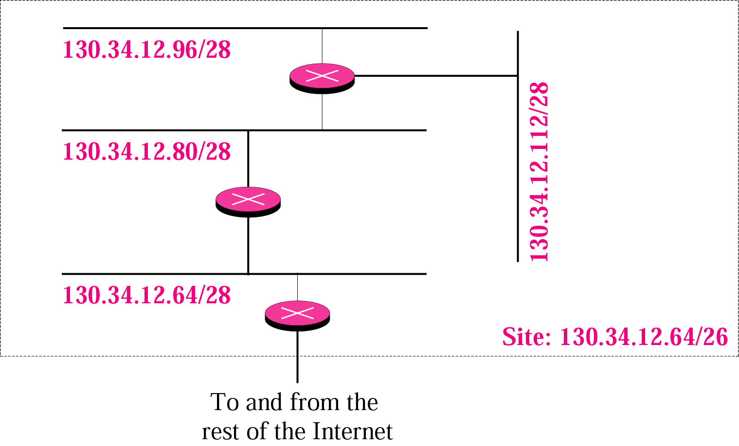
Example
‹#›
Notes:
‹#›

Slide 41
Variable-Length Subnets
In previous examples
All of subnets have the same mask
Variable-length subnet
Design subnets of different sizes
‹#›

Slide 42
Example-14
An organization is granted a block of addresses with the beginning address 14.24.74.0/24. There are 2³²⁻²⁴= 256 addresses in this block. The organization needs to have 11 subnets as shown below:
a. two subnets, each with 64 addresses.
b. two subnets, each with 32 addresses.
c. three subnets, each with 16 addresses.
d. four subnets, each with 4 addresses.
Design the subnets.
See Next Slide For One Solution
‹#›

Slide 43
Example-14
The first 128 addresses are used for the first two subnets, each with 64 addresses.
The mask for each network is /26.
(If each subnet needs 64 addresses, that is 2^6. 32-6 = /26)
The subnet address for each subnet is given in the figure
Use the next 64 addresses for the next two subnets, each with 32 addresses.
The mask for each network is /27.
(If each subnet needs 32 addresses, that is 2^5. 32-5=/27)
The subnet address for each subnet is given in the figure.
‹#›

Slide 44
Example-14
Use the next 48 addresses for the next three subnets, each with 16 addresses.
The mask for each network is /28.
The subnet address for each subnet is given in the figure
Use the last 16 addresses for the last four subnets, each with 4 addresses.
The mask for each network is /30.
The subnet address for each subnet is given in the figure
‹#›

Slide 45
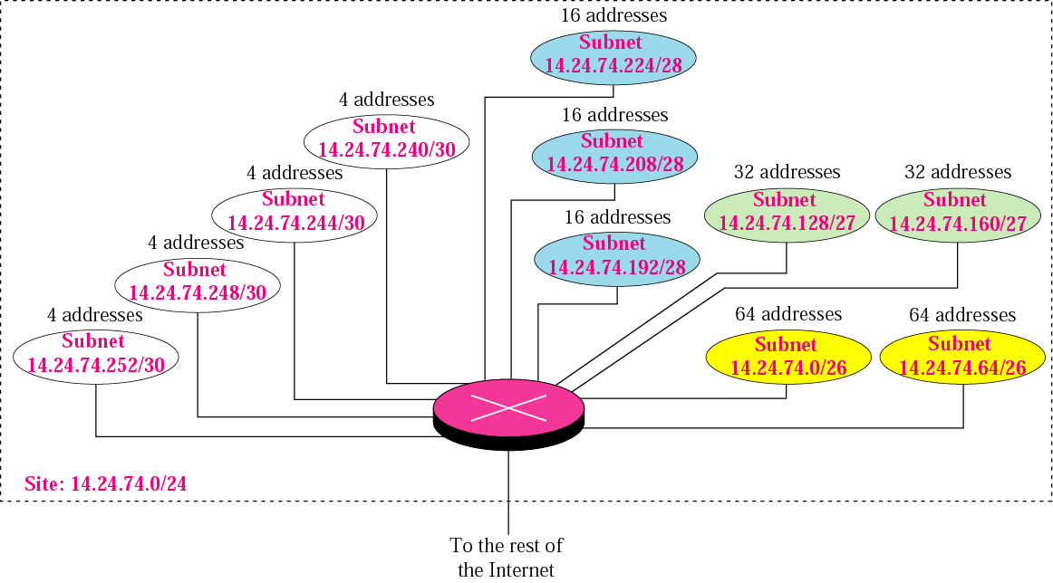
‹#›

Slide 46
Example-15
An ISP is granted a block of addresses starting with 190.100.0.0/16. The ISP needs to distribute these addresses to three groups of customers as follows:
The first group has 64 customers; each needs 256 addresses.
The second group has 128 customers; each needs 128 addresses.
The third group has 128 customers; each needs 64 addresses. Design the sub-blocks and give the slash notation for each sub-block. Find out how many addresses are still available after these allocations.
‹#›
Notes:
‹#›

Slide 47
Solution
Group 1
For this group of 64 customers, each customer needs 256 addresses. This means the suffix length is 8 (2⁸ = 256). The prefix length is then 32 − 8 = 24.
01: 190.100.0.0/24 🡺190.100.0.255/24
02: 190.100.1.0/24 🡺190.100.1.255/24
…………………………………..
64: 190.100.63.0/24🡺190.100.63.255/24
Total = 64 × 256 = 16,384
‹#›
Notes:
‹#›

Slide 48
Solution (Continued)
Group 2
For this group of 128 customers, each customer needs 128 addresses. This means the suffix length is 7 (2⁷ = 128). The prefix length is then 32 − 7 = 25. The addresses are:
001: 190.100.64.0/25 🡺190.100.64.127/25
002: 190.100.64.128/25 🡺190.100.64.255/25
…………………………………..
127: 190.100.127.0/25 🡺190.100.127.127/25
128: 190.100.127.128/25 🡺190.100.127.255/25
Total = 128 × 128 = 16,384
‹#›
Notes:
‹#›

Slide 49
Solution (Continued)
Group 3
For this group of 128 customers, each customer needs 64 addresses. This means the suffix length is 6 (2⁶ = 64). The prefix length is then 32 − 6 = 26.
001:190.100.128.0/26 🡺190.100.128.63/26
002:190.100.128.64/26 🡺190.100.128.127/26
…………………………
128:190.100.159.192/26 🡺190.100.159.255/26
Total = 128 × 64 = 8,192
‹#›
Notes:
‹#›

Slide 50
Solution (Continued)
Number of granted addresses: 65,536
Number of allocated addresses: 40,960
Number of available addresses: 24,576
The available addresses range from:
190.100.160.0 🡺 190.100.255.255
Total = 96 × 256 = 24,576
Another Example:
Given, 192.168.0.0/16 (host=1000->1024-> /22)
192.168.0.0/22 - 192.168.3.255/22
‹#›
Notes:
‹#›

Slide 51
Example-16
Assume a company has three offices: Central, East, and West.
The Central office is connected to the East and West offices via private, point-to-point WAN lines.
The company is granted a block of 64 addresses with the beginning address 70.12.100.128/26.
The management has decided to allocate 32 addresses for the Central office and divides the rest of addresses between the two offices.
Figure 5.8 shows the configuration designed by the management.
‹#›

Slide 52
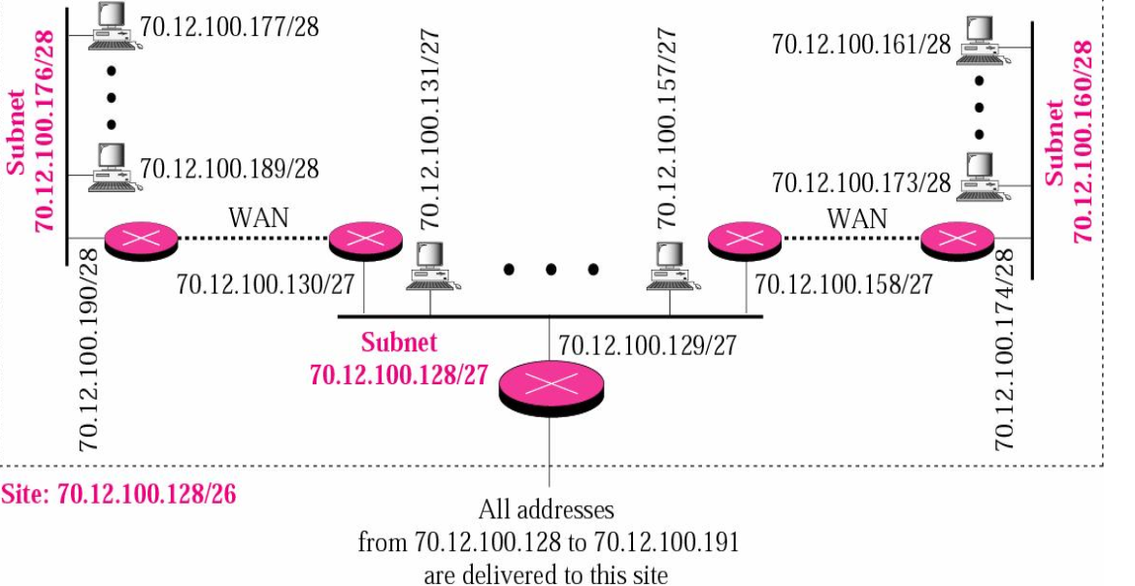
Example-16
‹#›

Slide 53
Solution
The company will have three subnets, one at Central, one at East, and one at West.
The Central office uses the network address 70.12.100.128/27.
This is the first address, and the mask /27 shows that there are 32 addresses in this network.
The addresses in this subnet are 70.12.100.128/27 to 70.12.100.159/27
Note that three of these addresses are used for the routers and the company has reserved the last address in the sub-block.
Note that the interface of the router that connects the Central subnet to the WAN needs no address
It is a point-to-point connection
‹#›

Slide 54
Solution (Continued)
The West office uses the network address 70.12.100.160/28.
The mask /28 shows that there are only 16 addresses in this network.
The addresses in this subnet are 70.12.100.160/28 to 70.12.100.175/28.
Note that one of these addresses is used for the router and the company has reserved the last address in the sub-block.
Note also that the interface of the router that connects the West subnet to the WAN needs no address
It is a point-to- point connection
‹#›

Slide 55
Solution (Continued)
The East office uses the network address 70.12.100.176/28. n The mask /28 shows that there are only 16 addresses in this network.
The addresses in this subnet are 70.12.100.176/28 to 70.12.100.191/28.
Note that one of these addresses is used for the router and the company has reserved the last address in the sub-block.
Note also that the interface of the router that connects the East subnet to the WAN needs no address
It is a point-to-point connection
‹#›

